Slide 1

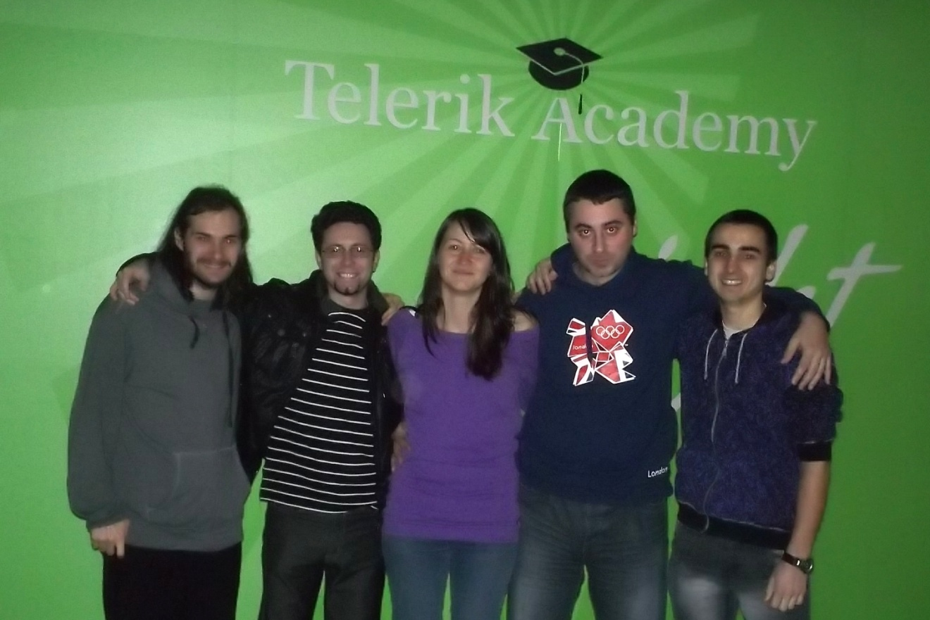
Evgeniy Boyadzhiev, Petar Velinov, Alexandra Atanasova, Angel Elenkov, Ferdi Nebiev

Slide 2

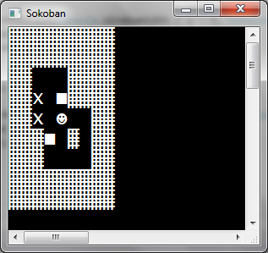
OUR PROJECT
- Player
- Box
- Target

